Slide 1
Area of Circles

Slide 2
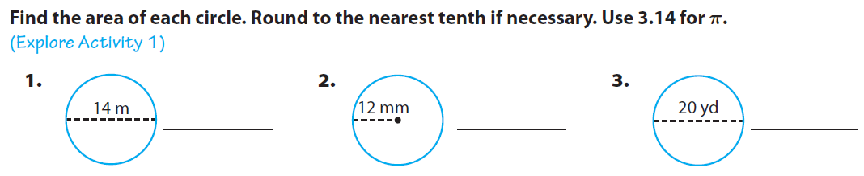
Warm Up

Slide 3
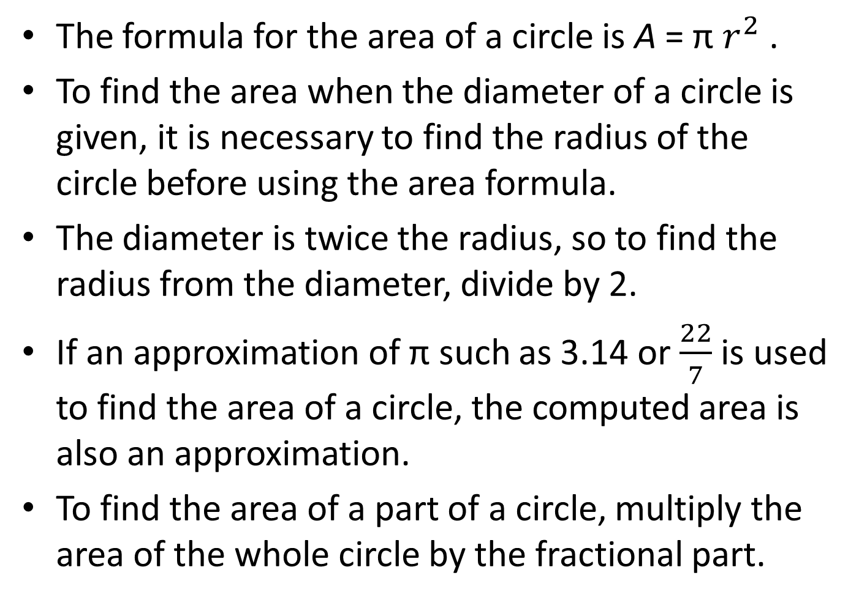
The formula for the area of a circle is A = π $r^{2}$ .
To find the area when the diameter of a circle is given, it is necessary to find the radius of the circle before using the area formula.
The diameter is twice the radius, so to find the radius from the diameter, divide by 2.
If an approximation of π such as 3.14 or $\frac{22}{7}$ is used to find the area of a circle, the computed area is also an approximation.
To find the area of a part of a circle, multiply the area of the whole circle by the fractional part.

Slide 4
Trinity draws a circle that has a radius of 7 cm. Ashley draws a circle that has a diameter of 12 cm. Which circle has the greater area? How much greater?

Slide 5
How could you find the area of a semicircle and the area of a quarter circle?
Multiply the area of the full circle by one-half to find the area of the semicircle and by one-fourth to find the area of the quarter circle.

Slide 6
How do you find the area of a circle when its diameter is given?
You must first divide the diameter by 2 in order to determine the radius of the circle; then you square the radius and multiply by π.

Slide 7
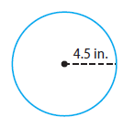
A remodeling project calls for sanding a chair with a disk sander. The sanding disk used on the sander has a radius of 4.5 inches.
Find the area of the disk.
Use 3.14 for π

Slide 8
What does it mean to solve C = 2πr for r?
It means to get r on one side of the equation; the expression on the other side can then be substituted for r in the next step.

Slide 9
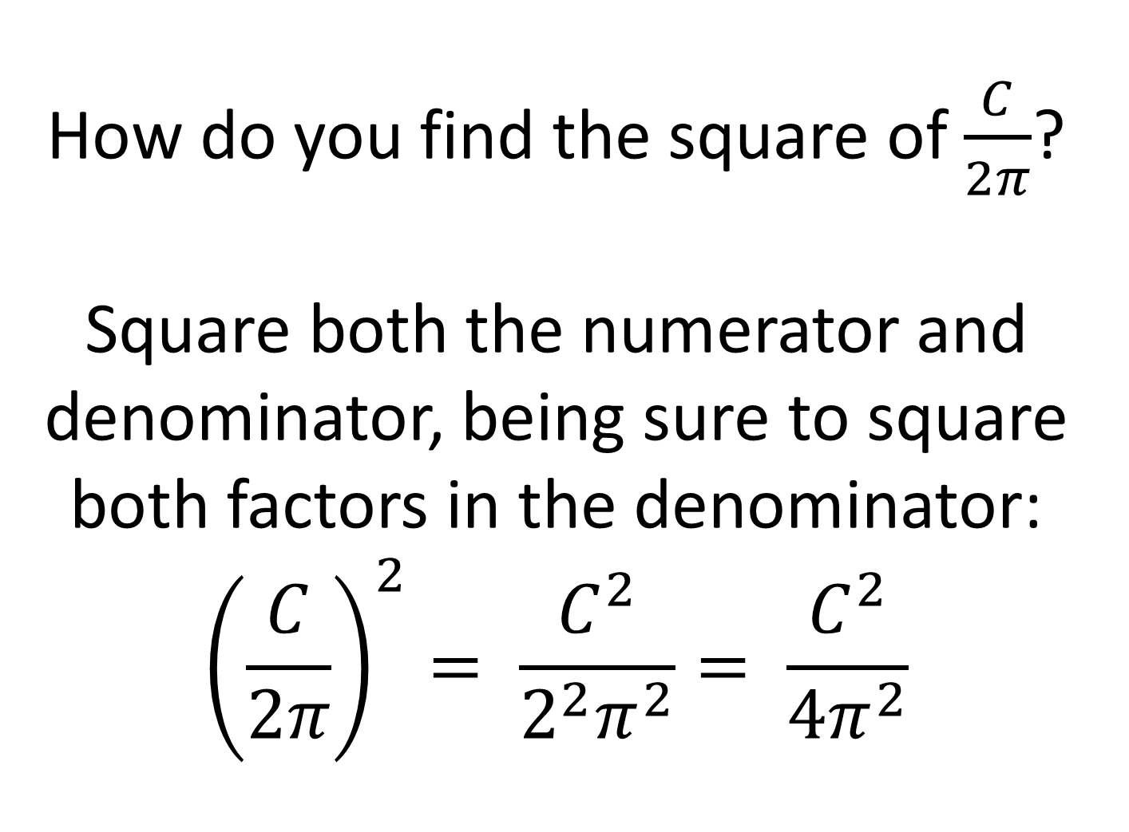
How do you find the square of $\frac{C}{2π}$?
Square both the numerator and denominator, being sure to square both factors in the denominator:
$${\left(\frac{C}{2π}\right)}^{2}= \frac{C^{2}}{2^{2}π^{2}}= \frac{C^{2}}{4π^{2}}$$

Slide 10
A stained glass window is shaped like a semicircle. The bottom edge of the window is 36 inches long. What is the area of the stained glass window? Round your answer to the nearest hundredth.

Slide 11
The sides of a square field are 12 meters. A sprinkler in the center of the field sprays a circular area with a diameter that corresponds to a side of the field. How much of the field is not reached by the sprinkler? Round your answer to the nearest hundredth.

Slide 12
A bear was seen near a campground. Searchers were dispatched to the region to find the bear.
Assume the bear can walk in any direction at a rate of 2 miles per hour. Suppose the bear was last seen 4 hours ago. How large an area must the searchers cover? Use 3.14 for π. Round your answer to the nearest square mile.
How much additional area would the searchers have to cover if the bear were last seen 5 hours ago?

Slide 13
The bull’s-eye on a target has a diameter of 3 inches. The whole target has a diameter of 15 inches. What part of the whole target is the bull’s-eye? Explain.

Slide 14
Exit Ticket
For 1–3, find the area of each circle. Use 3.14 for π. Round to the nearest hundredth if necessary.
1. a circle with radius 48 mm
2. a circle with diameter 8.4 ft
3. a circle with diameter 14 in.
4. The diameter of the face-off circle on an ice-hockey rink is 30 feet. Find its area.
5. A circle has a circumference of 16π yards. Find the area in terms of π.
6. The Garcia family bought 400 yards of fencing to enclose a circular wildflower garden. They will use all of the fencing.
a. What is the diameter of the garden?
b. Use your answer to part a to find the area enclosed by the fence.

